Slide 1
DIFFERENCE BETWEEN Agile and scrum

Slide 2
AGILE
What is Agile Methodology?
agile is a development method in which requirements and solutions evolve in cross-functional teams through collaborative effort. Its approach aligns project and product development with the customer's requirements and overall company goals. It is a methodology based on iterative development.
Benefits of using agile
Flexibility and Adaptability
Iterative Delivery
Customer Collaboration
Continuous Improvement
Increased Transparency

Slide 3
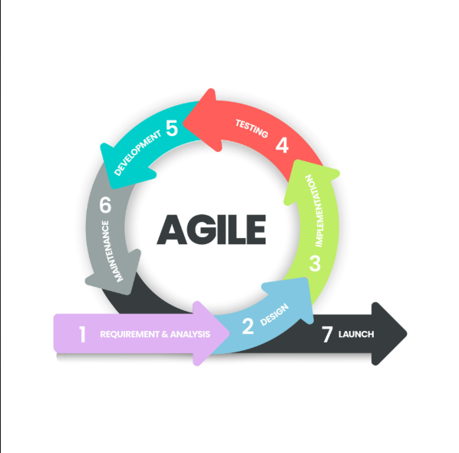
Agile diagram

Slide 4
Scrum
is one of the most popular agile methodologies. Scrum is a iterative, and incremental framework. Scrum breaks down the development phases into stages or cycles called "sprints". The development time for each sprint is maximized and dedicated thereby managing only one sprint at a time. The Scrum team has a scrum master and product owner with constant communication daily.
There are 5 scrum values:
Commitment
Focus
Openness
Courage
Respect

Slide 5
Scrum
Benefits of using the scrum methodology
Enhanced Team Collaboration
Iterative Progress
Improved Transparency
Disadvantages of using the scrum methodology
Here are the disadvantages of using the Scrum methodology:
Dependency on Team Communication
Time-Boxed Sprints
Potential for Team Burnout

Slide 6
DIFFERENCE BETWEEN AGILE AND SCRUM
Parameters | Agile | Scrum
Methodology | Agile is a set of principles that's iterative and incremental. | Scrum is an implementation of the agile methodology.
Leadership | The project head takes care of all tasks is vital to the project. | There's no leader, the scrum master, and the team addresses the issues. It involves cross-functional, self-organizing teams.
Flexibility | In agile, changes cannot be handled frequently. | It enables teams to react to changes quickly.
Delivery | The methodology requires frequent delivery to the end user. | With sprints, builds are delivered to clients for feedback.
Collaboration | Face-to-face interaction takes place between cross-functional teams. | Daily stand-up meetings help with collaboration.

Slide 7
Conclusion
Scrum is an implementation of the agile methodology. Both agile and Scrum methodologies prioritize flexibility and iterative development but they are different in their specific approaches. Ultimately, successful implementation relies on adapting these methodologies to fit unique requirements of each projects.

